Slide 1
IE 362 Lecture 12: Hashing
Il-Chul Moon
Department of Industrial and Systems Engineering
KAIST

Slide 2
Short recap

Slide 3
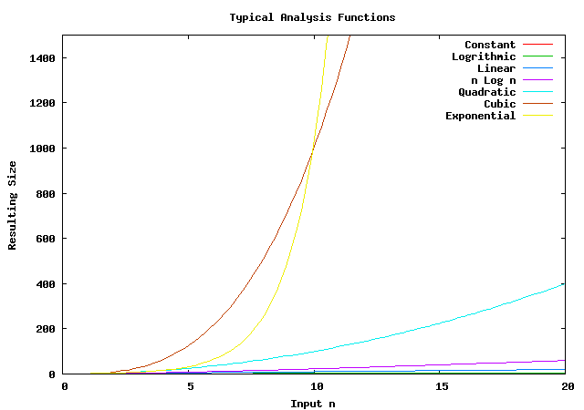
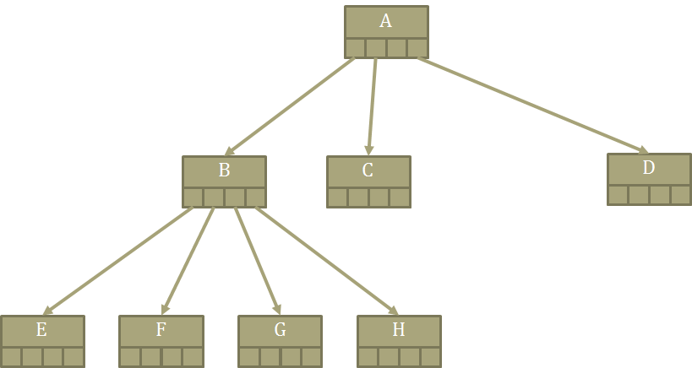
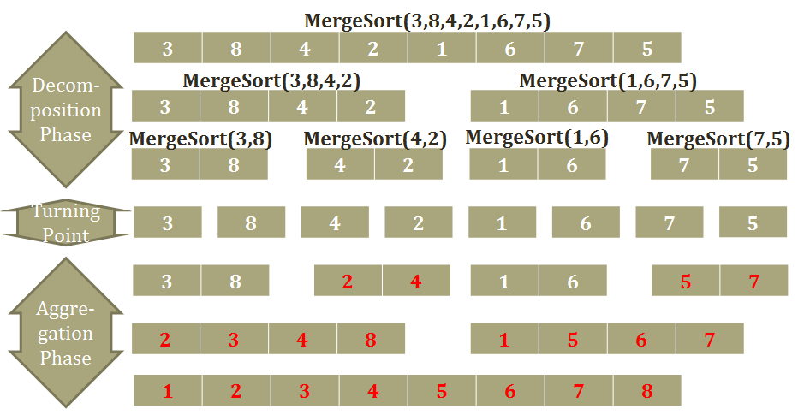
Limit of divide and conquer
The limitation of divide and conquer
If the divide and conquer is based upon a comparison
The efficiency is limited to the logarithm of the problem size
Search: O(N) → O(logN)
Sorting: O(N²) → O(NlogN)
Binary Search Tree
O(log N)
What-if O(1)?
You can’t achieve this through comparisons…
Merge-sort
O(Nlog N)

Slide 4



Hash table
Hash Table
Key | Idx | Value
…. | … | ….
Key₁ | 50
…. | … | ….
Key₂ from 801117 1234567 | 70
…. | … | ….
Key₃ | 97
…. | … | ….
Hash table
A large size of tables consisting of keys and values
Hash function is used to find an array index for a key
Definition
An array index: an index in the table
A key: a unique identifier of a value, a parameter to find its array index through hash functions
A value: a stored value
Characteristic
One key can be associated with one index
One index can be associated with multiple keys
Why?
An array element = a slot = a bucket

Slide 5
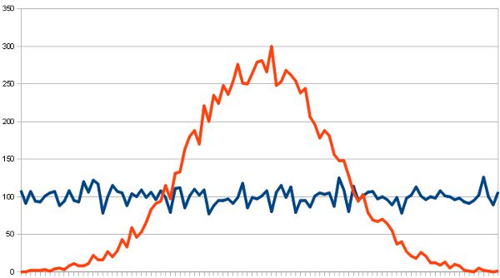
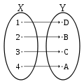
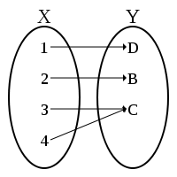
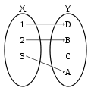
Hash function
Hash function is used to convert
Value’s key → Array’s index
For example, f(8011171234567) = 3
8011171234567 = a person’s register number
3 = an index where the person is stored
f = a hash function
Perfect hash function
Either, if we have an unlimited space
Or, if we have a limited input size
We might have a chance to create a bijective hash function
However, you have to know the characteristic of keys
Good hash function
Hash function resulting in a uniform distribution
Why is this a good hash function?
Why is this difficult?
Pseudo-random….
Any relation to the password encryption algorithm?
Low cost, determinism, variable range….
Bijective Function
Surjective Function
Injective Function

Slide 6
Modulo based hash function
Modulo based hash function
We divide a numeric key with a number
Often, a number = the size of the hash table
We take the remainder as an array index
For example,
Index = Key mod Size
34567 = 8011171234567 mod 50000
But, 34567 = 8011171284567 mod 50000
Why is this often used?
Good variable range
Appears to be uniform
But, actually it is not
Still, surjective function

Slide 7
Collision resolution by closed addressing
Collision resolution by closed addressing
Separate chaining
Live together approach
The worst case scenario
Every entries have the same index from a stupid hash function
Just another linked list
Considering the load factor
Load factor > 1 is possible
This case means that every index has one or more entries
Then? Only use the linked list for each bucket? Trees can be used as well…
Idx | Head of a Linked List
… | ….
50
… | ….
Okay. I will pass you whenever I go in and out
Put yourself at my tail

Slide 8

Collision resolution in open addressing
Linear probing: Okay… I will go to the next bucket
Collision resolution by open addressing
Resolution by probing
See where an empty bucket is
I don’t want to live with you, so get out and find your own place approach
Various probing
Linear probing – see whether the next bucket is empty or not
Index = ( f(Key) + i ) mod S
Quadratic probing
Index = ( f(Key) + i + i² ) mod S
i = number of trials
S = size of the hash table
Why quadratic probing?
Uniformity of a hash function
Because of a cluster
Key | Idx | Value
…. | … | ….
f(Key₁)=50 | 50
f(Key₂)=50 | 51 | Empty
…. | …. | ….
…. | …. | ….
…. | …. | ….
f(Key₂)=50 | 99 | Empty
…. | …. | ….
Quadratic probing: Okay… I will go to a bucket far away…

Slide 9
Deletion in open addressing hash table
f(K) = K mod 5
Open addressing
Linear probing
0 | 1 | 2 | 3 | 4
 | 1 | 6 | 11
Deletion
Closed addressing
Simple
Go to the bucket, and follow the linked list, and delete it
Open addressing
Complicated
Intuitively…
Visit the index from the hash function
If it is there, delete it
If not, keep following the probing method, find and delete it
What is wrong with this idea?
Problem scenario?
Insert an 1, 6, 11 with the same index from hash functions, resolved by linear probing
Deleting 6
And, searching 11 ← Problem!
Then?
Lazy deletion
You just mark it and do not delete it
Keep adding entries and no deletion
Why? Cheap storage cost
But, always there is a limit
Delete 6
0 | 1 | 2 | 3 | 4
 | 1 |  | 11
Search 11
0 | 1 | 2 | 3 | 4
 | 1 |  | 11

Slide 10
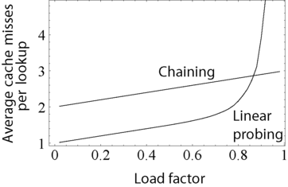
Managing the hash table size
There is always a limit
Even though the storage is cheap
You don’t have an infinite storage
If you don’t delete entries
Keep adding more entries
Then, the table’s load factor becomes higher
What this mean?
More probing to insert
Hence, sometimes
You need to extend the storage space
And insert the entries to the new space with more buckets

Slide 11
Offline class plan

Slide 12
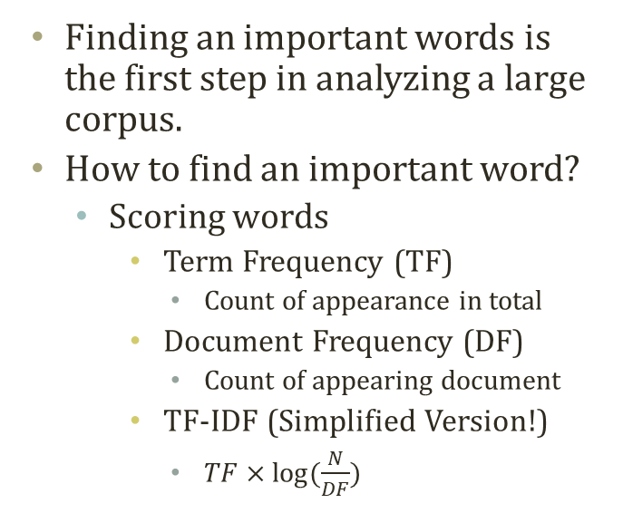
Text Analysis with Keywords
Finding an important words is the first step in analyzing a large corpus.
How to find an important word?
Scoring words
Term Frequency (TF)
Count of appearance in total
Document Frequency (DF)
Count of appearing document
TF-IDF (Simplified Version!)
$TF×log⁡(\frac{N}{DF})$
Num | TF_Words | TF_Values | DF_Words | DF_Values | TFIDF_ Words | TFIDF_ Values
0 | the | 2150 | Path: | 100 | # | 491.2209
1 | to | 1233 | From: | 100 | . | 370.8236
2 | of | 1109 | Newsgroups: | 100 | MR. | 299.3361
3 | and | 875 | Subject: | 100 | STEPHANOPOULOS: | 299.3361
4 | a | 678 | Message-ID: | 100 | Q | 255.9787
5 | that | 632 | Date: | 100 | > | 227.5664
6 | in | 585 | Lines: | 100 | Rockefeller | 202.6275
7 | is | 525 | Apr | 99 | South | 196.7852
8 | I | 373 | Organization: | 95 | ] | 191.6891
9 | for | 372 | of | 94 | is | 179.8074
10 | > | 348 | to | 94 | was | 176.9108
11 | are | 344 | the | 94 | secret | 173.7525
12 | you | 286 | GMT | 92 | in | 168.294
13 | be | 275 | a | 88 | naval | 161.181
14 | not | 262 | and | 87 | been | 151.2872
15 | on | 259 | References: | 85 | The | 149.1964
16 | it | 254 | Re: | 80 | Georgia | 148.6569
17 | as | 253 | that | 80 | war | 147.2754
18 | was | 248 | In | 76 | military | 143.7689
19 | with | 244 | in | 75 | that | 141.0267
A,B,B,B,C….
B,C,D….
A,C,….
B’s TF = 4,
B’s DF = 2,
B’s TF-IDF = 4*log(3/2)

Slide 13
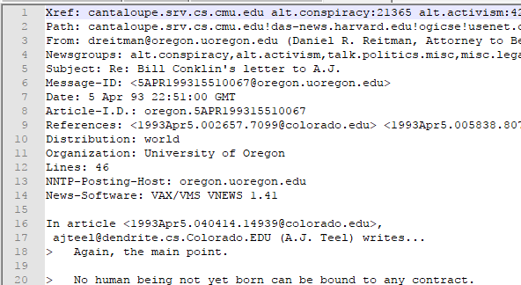
20 Newsgroup
20 Newsgroup is a text dataset collecting news articles and responses on various subjects.
Very popular text-mining benchmark dataset
Original raw text requires parsing
BagOfWordCreator.py
Does the parsing for you
Calculate the bag-of-word for you
self.words
['Xref:', 'cantaloupe.srv.cs.cmu.edu', 'alt.news-media:739', 'alt.politics.elections:6015', 'talk.politics.misc:124146', ………..
self.bows
{0: 1, 1: 1, 9882: 1, 9883: 1, 9884: 1, 9885: 1, 5: 1, 9886: 1, 7: 1, 5748: 1, 5567: 2, ………………

Slide 14
To-Do : Code Completion and Exp.
You need to complete the codes in ‘HashTable.py’ and ‘BagOfWordCreator.py’
Complete the code using a hash to create a dictionary in the Bag of Word
Complete the hash table
To-do 1) complete ‘calculateHashFunction’ in ‘HashTable.py’
Hash value = Sum(ord(character)^2)
ord(‘a’) = 97
To-do 2) complete ‘get’ in ‘HashTable.py’
Quadratic probing should be used
To-do 3) complete ‘put’ in ‘HashTable.py’
Quadratic probing should be used
To-do 4) complete ‘doubleSize’ in ‘HashTable.py’
Retrieve all key-pair and put them into a new hash
Copy the reference of the internal structure of the new hash to the old one
Keys, capacity, size, data
To-do 4) complete ‘createBowWithHash’ in ‘BagOfWordCreator.py’
idxWord is the value
New word’s index == the length of word
Token is the key

Slide 15
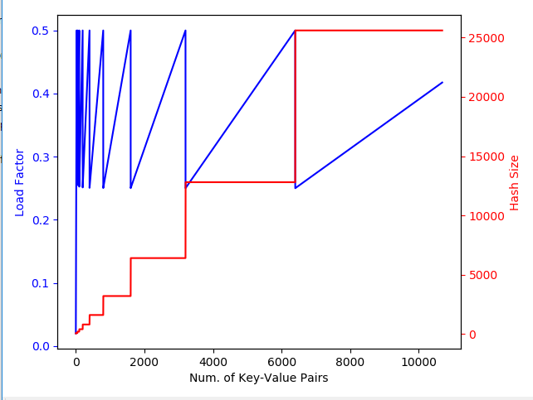
Expected Result
Execute ‘BagOfWordCreator.py’

